Slide 1
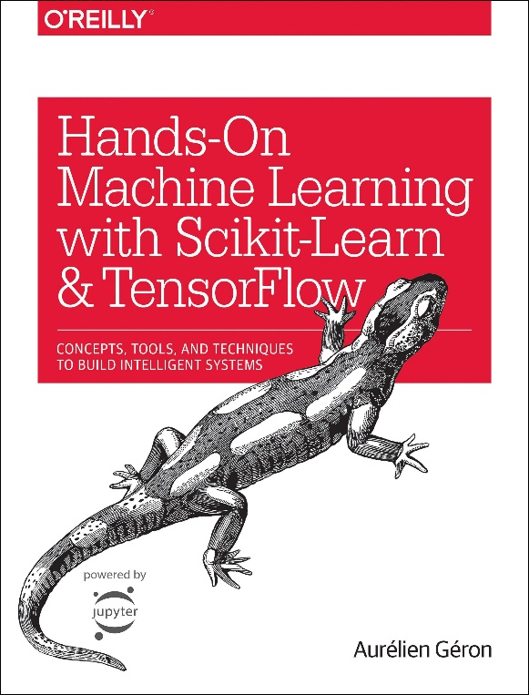
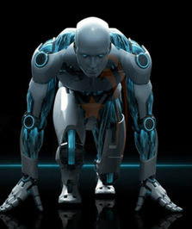
Novice Machine Learning E2E Project
Part 10
Pipelines
Mukunthan Ragavan

Slide 2
E2E Machine Learning Project
Look at the Big picture.
Get the Data (Split the Data, Stratifying the Data).
Discover and visualize the data to get insights.
(Scatter with plot with density and color map, Correlation)
Prepare the data for ML algorithms. (Data Cleaning, One Hot Encoding, Custom Transformers, Pipelines)
Select a model to train it.
Fine-tune your model.
Present your solution.
Launch, monitor and maintain your system.

Slide 3
Pipelines - many data transformation steps that need to be executed in the right order.
Pipeline
Transformers list
Pipeline object with data as arg
Column
Transformer
Pipelines or
Transformer with columns
Column-Transformer object with data as arg

Slide 4
Coding in action !

Slide 5
Thanks All for watching and your subscription !

